Slide 1

Title Layout
Rensildi Kalanxhi

Slide 2
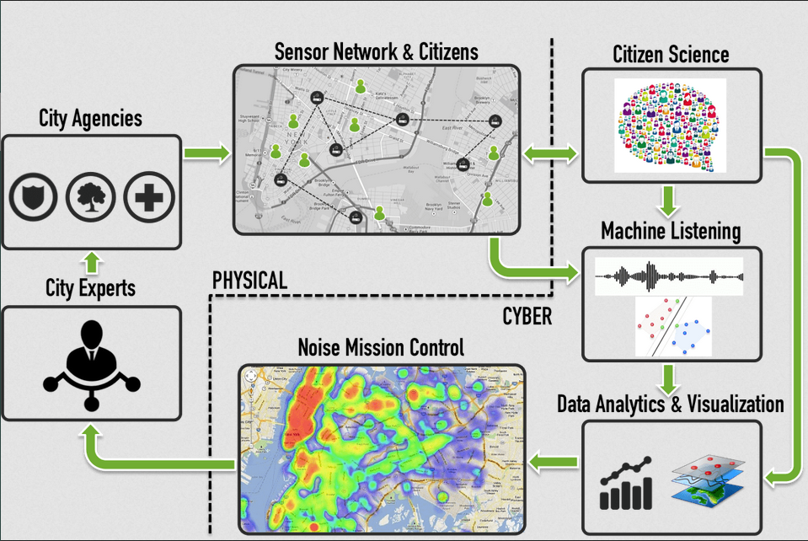
What is SONYC?
Sounds of New York City (SONYC)
Is a wireless sensor network
Goals
Monitor
Analyze
Reduce noise pollution
Notes:
Cyberphysical system, which includes

Slide 3
Why SONYC was created?
Noise Pollution
Short-Term Effects
Sleep disruption
Stress
Long-Term Effects
Cardiovascular disease
Hearing loss
Notes:
In New York, citizens can call 311 to make noise complains. If a certain volume of complaints occur in a specific location, an inspector is sent to investigate the noise.
Unfortunately the turnaround time is not fast enough to deal with most complaints and there is typically a four or five days delay in their response.

Slide 4
MKI (Mach 1) & MKII (Mach 2)
Old SONYC relied on MKI
Raspberry Pi-based devices
Required power & Wi-Fi infrastructure
Limited deployment to only ~3% of NYC
MKII motes (solved the previous problems/limitations)
Real-time noise classification
Solar powered (no power infrastructure)
LoRa networking replaced city Wi-Fi

Slide 5
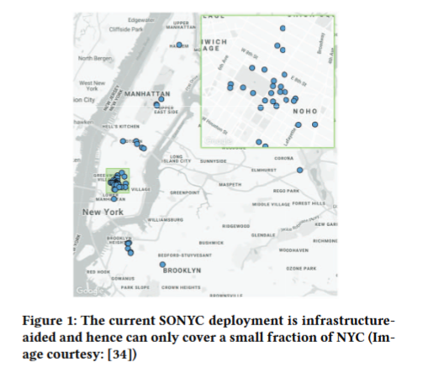
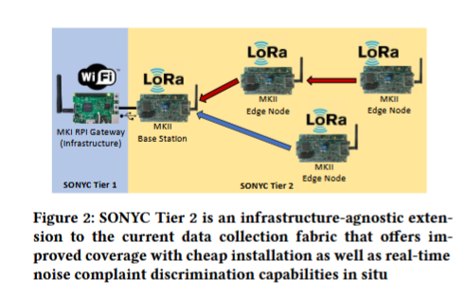

Slide 6
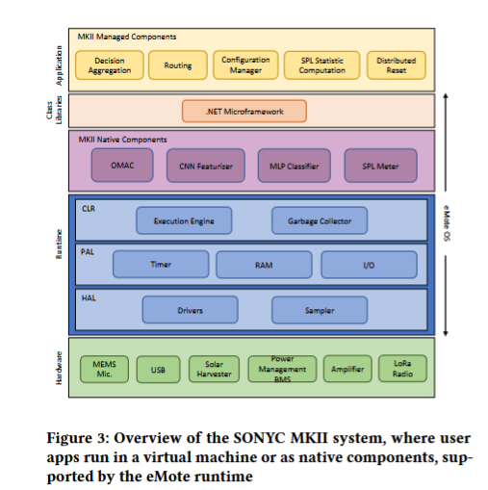
MKII 4 key hardware components
Digital 12S MEMS
Microphone for audio sensing.
LoRa radio chip (SX1276)
Long-range communication.
Solar-powered battery system
Energy management.
ARM Cortex-M7 microcontroller
Real-time processing & low power.
Notes:
MKII motes are designed for autonomous infrastructure-free deployment.
It uses:
5W solar panels and lithium-titanate (LTO) batteries for year-round power.
A software-defined Battery Management System (BMS) that optimizes charging and prevents failure.
Multi-hop LoRa networking, enabling devices to communicate over long distances.

Slide 7
Whats eMote runtime?
Efficient execution
ML models
Networking
System management
Integrates with SONYC infrastructure
Data transfer
Cloud-based visualization
Notes:
In New York, citizens can call 311 to make noise complains. If a certain volume of complaints occur in a specific location, an inspector is sent to investigate the noise.
Unfortunately the turnaround time is not fast enough to deal with most complaints and there is typically a four or five days delay in their response.

Slide 8
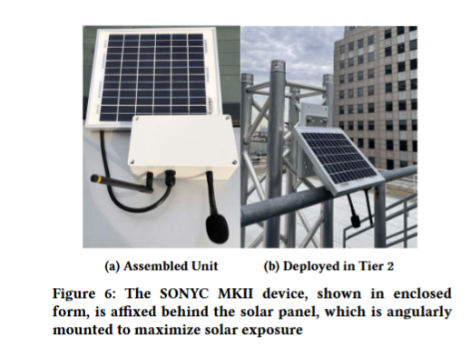
MKII
Notes:
In New York, citizens can call 311 to make noise complains. If a certain volume of complaints occur in a specific location, an inspector is sent to investigate the noise.
Unfortunately the turnaround time is not fast enough to deal with most complaints and there is typically a four or five days delay in their response.

Slide 9
SONYC-L3
CNN audio embedding model (mote-scale deployment)
Reducing input resolution
Lower sampling rate
Halving convolutional filters
Minimize activation memory
Applying 8-bit quantization
Reduce memory usage by 100x
Using Specialized Embedding Approximation (SEA)
Knowledge distillation
Training data reduced by 10x
Notes:
In New York, citizens can call 311 to make noise complains. If a certain volume of complaints occur in a specific location, an inspector is sent to investigate the noise.
Unfortunately the turnaround time is not fast enough to deal with most complaints and there is typically a four or five days delay in their response.

Slide 10
SONYC-L3 evaluation
Superior accuracy to larger models while requiring ~1MB memory
L3-Net
EdgeL3
Notes:
In New York, citizens can call 311 to make noise complains. If a certain volume of complaints occur in a specific location, an inspector is sent to investigate the noise.
Unfortunately the turnaround time is not fast enough to deal with most complaints and there is typically a four or five days delay in their response.

Slide 11
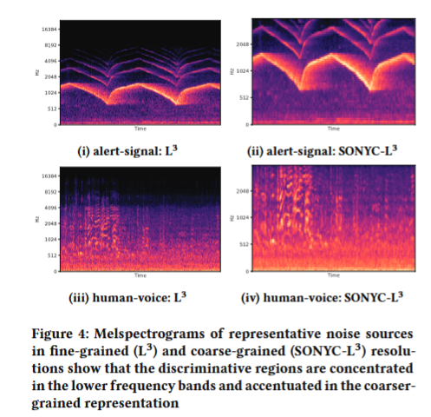
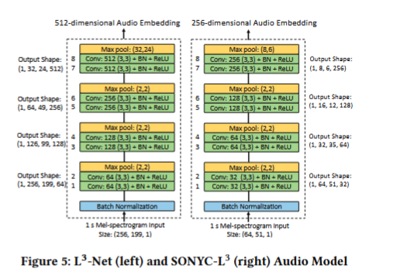
SONYC-L3 vs L3-Net & L3
Comparison of melspectrograms
SONYC-L3 is a reduced version of L3-NET with CNN optimization layers for low-power execution
Notes:
In New York, citizens can call 311 to make noise complains. If a certain volume of complaints occur in a specific location, an inspector is sent to investigate the noise.
Unfortunately the turnaround time is not fast enough to deal with most complaints and there is typically a four or five days delay in their response.

Slide 12
SONYC-L3 evaluation
Superior accuracy to larger models while requiring ~1MB memory
L3-Net
EdgeL3

Slide 13
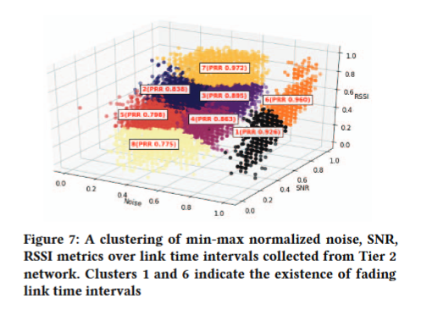
Management of External Interference
902-928 MHz ISM band in urban areas.
High interference
Signal fading
Solution:
Monitor noise, RSSI, and SNR in different frequencies.
Select most stable frequency (using passive and activate scanning)
Pre-node selection (Adapt dynamically locally)
Network-Wide Optimization (Adapt dynamically globally)
Notes:
Testing shows that MKII maintains high packet reception raters (PRR) by selecting optimal frequencies in real-time.
Figure-7: Clustering analysis reveals periods of links fading and interference across frequencies.

Slide 14
SONYC-L3 evaluation
Superior accuracy to larger models while requiring ~1MB memory
L3-Net
EdgeL3

